Slide 1

THDC INSTITUTE OF HYDROPOWER ENGINEERING AND TECHNOLOGY (DEPARTMENT OF ELECTRONICS AND COMMUNICATION ENGINEERING)
MAJOR PROJECT SYNOPSIS PRESENTATION
ON
SOLAR POWERED AGROBOT
SUBMITEED BY – Abhishek Saini ( 200970102001 ) UNDER THE SUPERVISION OF : MRS. ANOOPSHI JOHARI
Ajay singh ( 200970102002 )
Hritik Saini ( 200970102005 )
Tushar Dhiman (200970102008)

Slide 2
TABLE OF CONTENTS
1 Introduction
2 Required Components
3 Block Diagram
4 Components & Their description
5 Working
6 Advantages
7 Future Scope
8 References

Slide 3
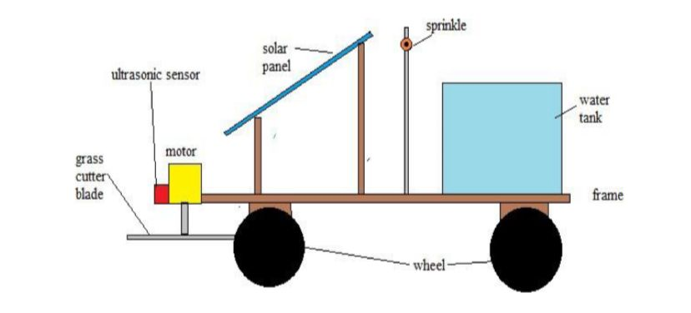
INTRODUCTION
In this project, the robot system is used to develop the process of cultivating agricultural land with the use of solar power.
The aim of the project is to reduce the man power, time and increase the productivity rate.
The entire basic robot works like Sowing, Grass cutting, water sprinkling and so on.

Slide 4
PROBLEM STATEMENT
About 51% Percentage of our Population is Indulge In agriculture Activity Which is only 15% of our GDP.
The main problem behind it is disguised unemployment that means more man power contribution than required.
SOLUTION
Automation of agriculture can be a revolutionary solution for this problem as it decrease manpower needed and increase overall production efficiency.

Slide 5
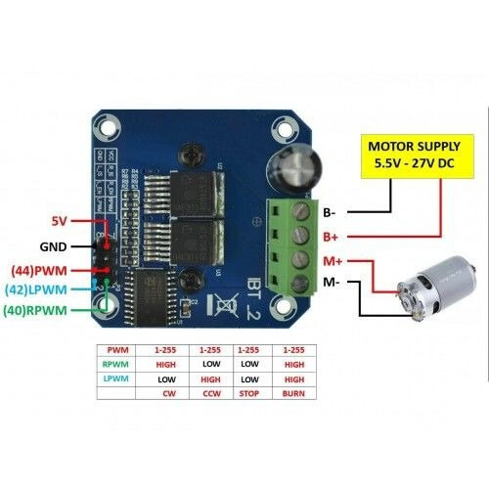
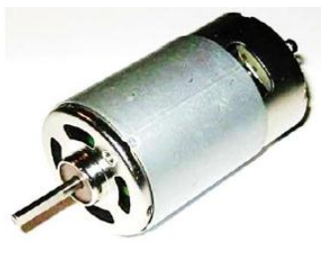
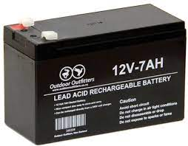
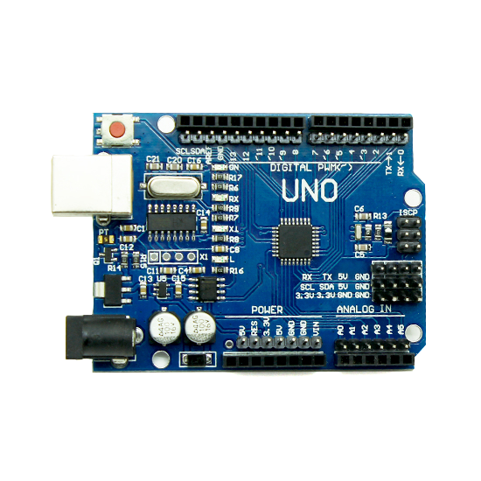
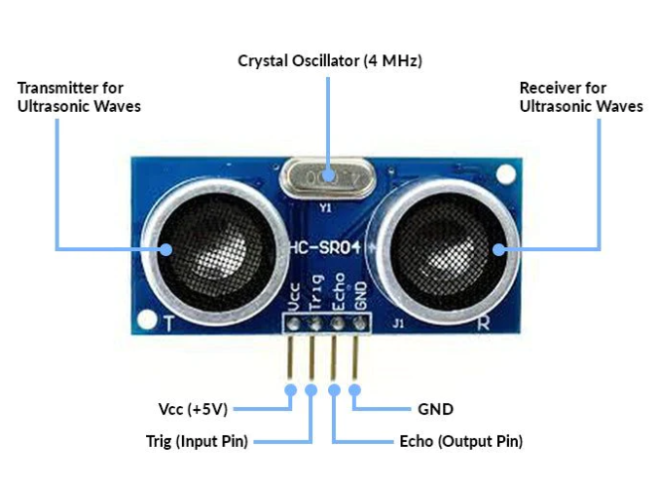
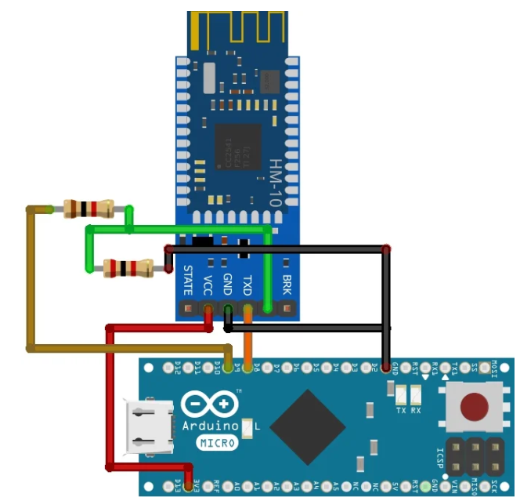
COMPONENTS REQUIRED
NAME OF COMPONENTS | QTY
Arduino Controller nano 1
Solar Panels 1
DC Motor 6
Ultrasonic Sensor 1
DC Motor Speed Controller 2
Bluetooth Module 1
12V Battery 1
Pesticide Pump 1
BTS 7960B MOTOR DRIVER 2

Slide 6
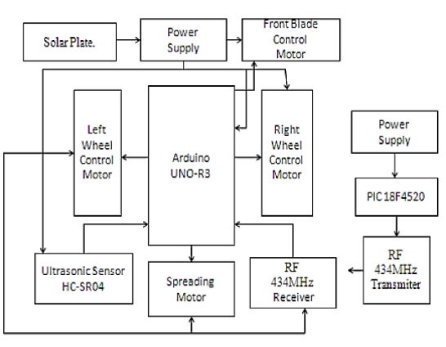
PURPOSED BLOCK DIAGRAM
BLUETOOTH

Slide 7
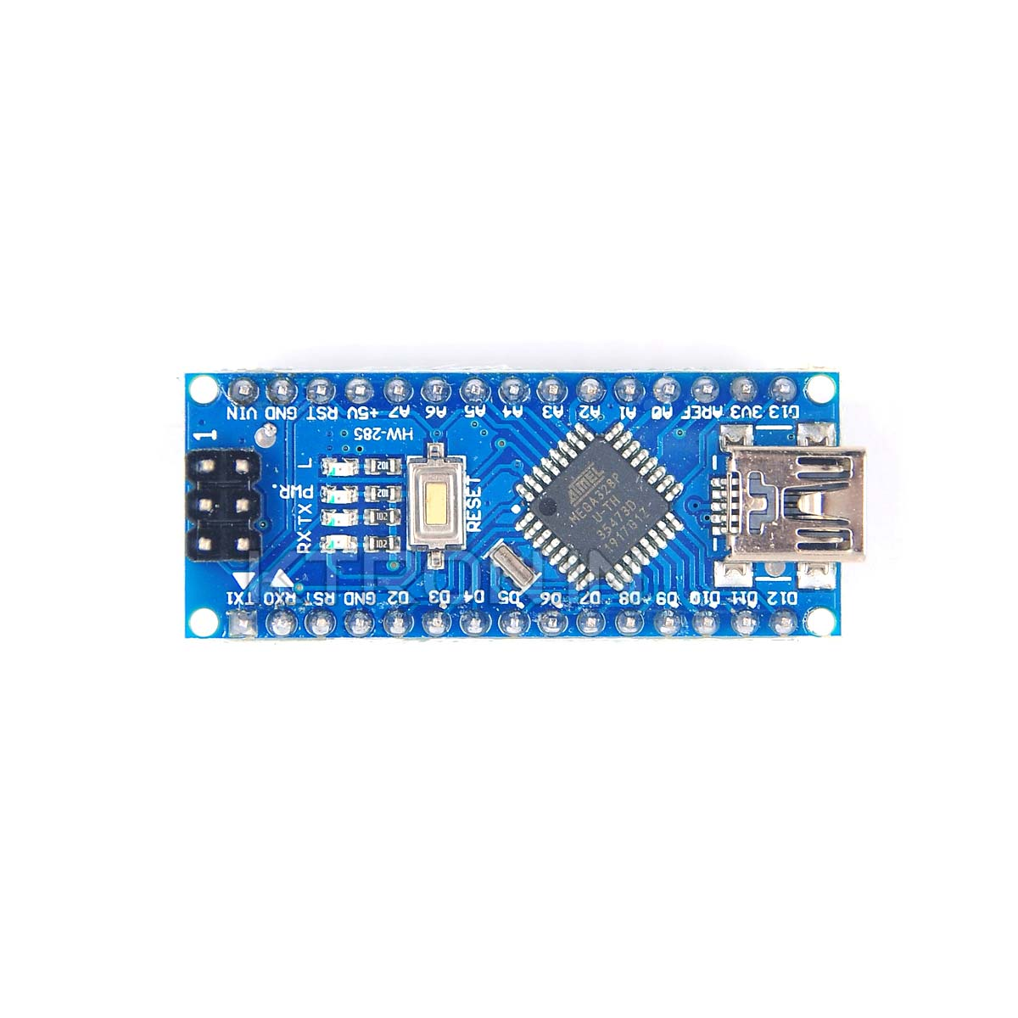
ARDUINO NANO CONTROLLER
The Arduino Nano is equipped with 30 male I/O headers, in a DIP-30-like configuration, which can be programmed using the Arduino Software integrated development environment (IDE), which is common to all Arduino boards and running both online and offline. The board can be powered through a type-B mini-USB cable or from a 9 V battery.
It has a 16 MHz resonator, a USB connection, a power jack, an in-circuit system programming (ICSP) header, and a reset button.
It contains everything needed to support the microcontroller; simply connect it to a computer with a USB cable or power it with an AC-to-DC adapter or battery to get started.

Slide 8
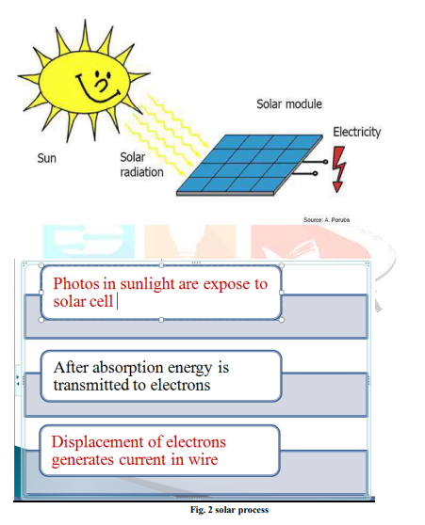
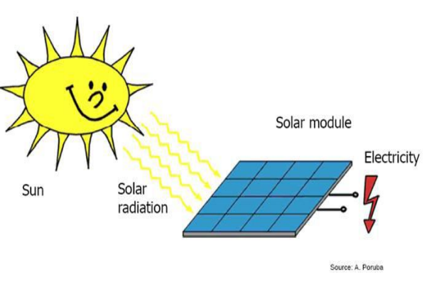
SOLAR PANEL
Solar panels convert solar energy into electricity. They use the concept of photoelectric effect, emission of electrons when light falls on solar panel.
When light falls on silicon cell, the outer most electrons of silicon i.e. two electrons are set into motion. This initiates the flow of electricity.

Slide 9
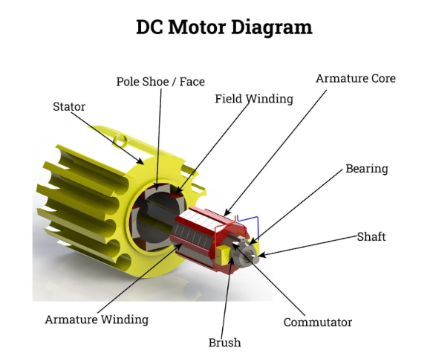
DC MOTOR
DC Motor An electric motor is an electrical machine which converts electrical energy into mechanical energy.
The basic working principle of a DC motor: "whenever a current carrying conductor is placed in a magnetic field, it experiences a mechanical force".
The direction of this force is given by Fleming's left-hand rule and its magnitude is given by F = BIL.
Where, B = magnetic flux density, I = current and L = length of the conductor within the magnetic field.

Slide 10
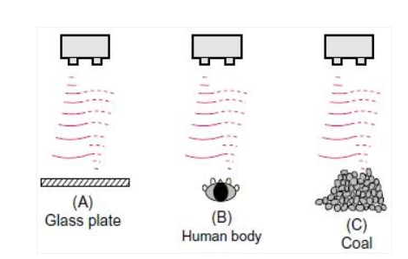
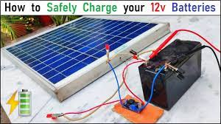
ULTRASONIC SENSOR
An ultrasonic sensor is a device that uses sound waves to detect the presence and proximity of objects. An ultrasonic sensor uses a transducer to send and receive ultrasonic pulses that relay back information about an object's proximity.
12V LITHIUM ION BATTERY
Rechargable battery Used for Power storage purpose

Slide 11
BT HC-05
HM-10 has the latest 4.0 Bluetooth technology.
There is no limit in sending bytes with HM-10.
Power consumption is much less even in an operating state with this module.
The HC10 module uses the 2.5GHz frequency band at the range of 100meter in an open area.
It is useable as a Master or Slave just by disconnecting the connections.
The module operates at 2-3.7V only which is common in every TTL/CMOS device.
A single module has its 256Kb flash memory and 8Kb SRAM.
There are onboard GPIO pins within the module which are usable through UART communications,

Slide 12
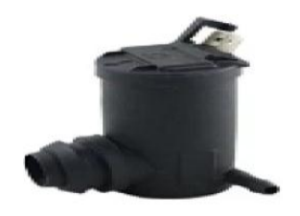
Pesticide pump
Operating voltage 12v Current-0.1A-0.5A Lift-130cm Flow Rte-300L/H
Driver Motor
The BTS 7960 bridge motor driver provides a cost optimized solution for protected high current PWM motor drives with very low board space consumption. This 43A H-Bridge Motor Driver provides protection against overtemperature, overvoltage, under voltage, overcurrent and short circuit.

Slide 13
DC MOTOR SPEED CONTROLLER
The motor speed controller can easily provide a continuous current of 3A to your DC motor or other DC load.
This DC speed controller has a voltage range: DC6V-28V and current range within 3A Switch function: None Speed range: 0-100%.
This DC motor speed controller connected to a DC power supply, do not directly connected to 220V AC
The 1203B DC Motor Speed Regulator controls the speed of a DC motor by adjusting Pulse-Width-Modulated (PWM).
The motor speed controller can easily provide a continuous current of 3A to your DC motor or other DC load.

Slide 14
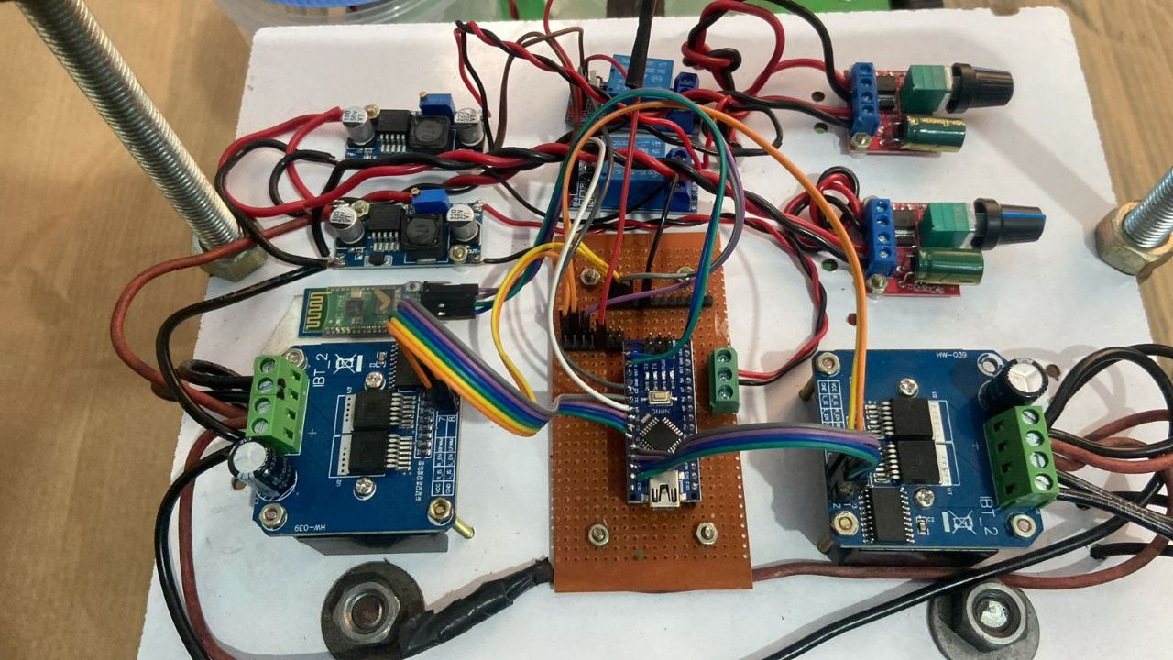
CONNECTING ALL MODULE

Slide 15
WORKING
Arduino Nano plays the main controlling role in this project.It has been programmed in a manner that, it controls the different lawn mower actions. The working principle of solar Agrobot is it has panel mounted in a particular arrangement in such a way that it can receive solar radiation with high intensity easily from the sun.
These solar panel convert solar energy into electrical energy.Six DC gear motors (10,000 RPM) are used to move the solar grass cutter, and one DC blade motor (7000-13,000 RPM) is used to cut the grass quickly. Also the second application is the pesticide spreading.
For this we use the 12v dc operated pump with the 1.5m length pipe and the spreading nozzle is connected at one end of the pipe. For supplying water and storing pesticide we use the water tank of 1 liter.

Slide 16
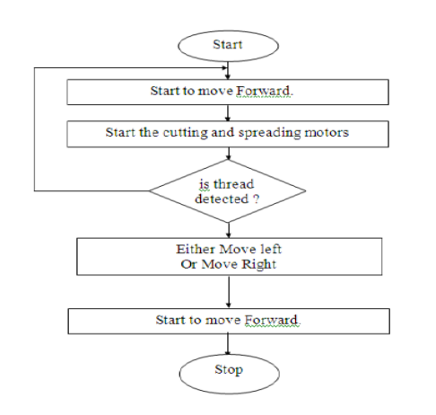
FLOW CHART

Slide 17
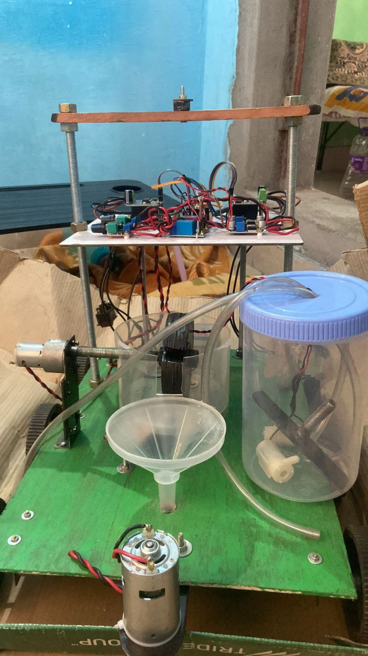
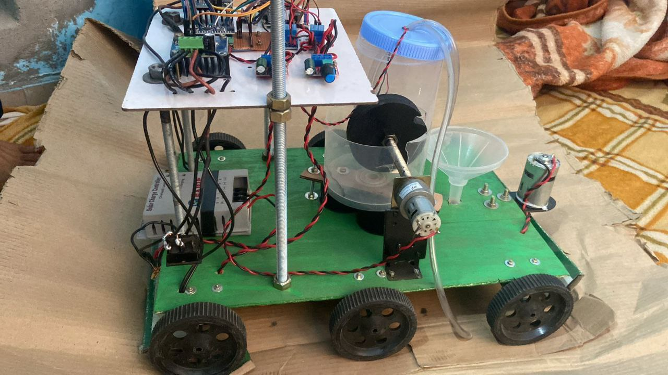
PROJECT

Slide 18
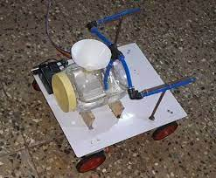
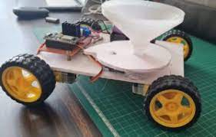
ADVANTAGES
Our project work has presented progress towards achieving a future precision autonomous farming system.
This system is designed to help farmers in reducing their time and energy spent for pesticide spraying and weed cutting which reduces labour problem in future.
Sowing Robot
Pesticide Robot

Slide 19
FUTURE SCOPE
∙ Sensor Integration: Integrate advanced sensors for real-time data collection, enabling the robot to make informed decisions and adapt to changing field conditions.
∙ Machine Learning and AI: Implement machine learning and artificial intelligence algorithms to enhance the robot's decision-making capabilities, improving task efficiency and resource management.
∙ Multi-Robot Systems: Develop the concept of swarm robotics, where multiple robots can work collaboratively in a coordinated manner, covering larger areas and tackling complex tasks.
∙ Energy Efficiency: Explore energy-efficient technologies and storage solutions to ensure uninterrupted robot operation, even during cloudy or nighttime conditions.

Slide 20
REFERENCES
[1] Laukik P. Raut, Smit B. Jaiswal, Nitin Y. Mohite. (2013, Nov.) “Design, development and fabrication of agricultural pesticides sprayer with weeder”, International Journal of Applied Research and studies, pp. 1-8.
[2] Prashant M. Chavan, Gayatri P. Chavan, "Interfacing of Wind Energy to Grid using Static Compensator and Load Reactive Power Compensation", Information Communication Engineering and Technology (ICICET) 2018 International Conference on, pp. 1-4, 2018.
[3] P. M. Chavan, Girish R. Walake, "Interfacing of Renewable Energy Source to Grid Using STATCOM to Improve the Power Quality", international Journal of Engineering Technology Management and Applied Sciences, vol. 3, no. 3, pp. 2349-4476, March 2015.
[4] Prashant M. Chavan, Girish R. Walke, “Using STATCOM interfacing of renewable energy source to grid and power quality improvement”, 2015 International Conference on Energy Systems and Applications, 30 Oct.-1 Nov. 2015, Pune, India.
[5] Prashant M Chavan, Dhiraj V Khurde, Sushant N Adepwar, Shubham S Kute, Dipannita R Kundu, “Solar Powered Electric Grass Cutter, Pesticides Sprayer and Lighting Unit”, International Journal of Research in Engineering, Science and Management, Volume 2, Issue 11, November-2019.

Slide 21
THANK YOU

